Slide 1







Selling Sunset
AI Edition
In Italy

Slide 2
Purpose/ Overview
Italian Real Estate Market influenced by diverse factors
Apply Machine Learning Techniques to a real-world problem
Assist homebuyers, realtors, & property investors in estimating selling price of residential properties
Analyzing historical housing data and relevant features to provide accurate and data-driven pricing predictions
Programs: Pandas, Matplotlib, SQL Database, Tableau

Slide 3
Scope
Gather a dataset of residential properties that includes essential attributes such as (square footage, number of bedrooms and bathrooms, location, zip, neighborhood), amenities, historical sale prices, and other relevant features.
Ensure data quality and accuracy
Explore data sources, such as public real estate listings, government data, or real estate APIs

Slide 4
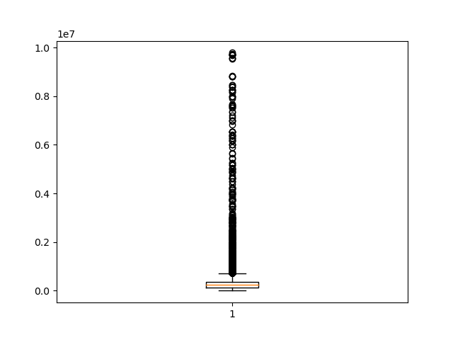
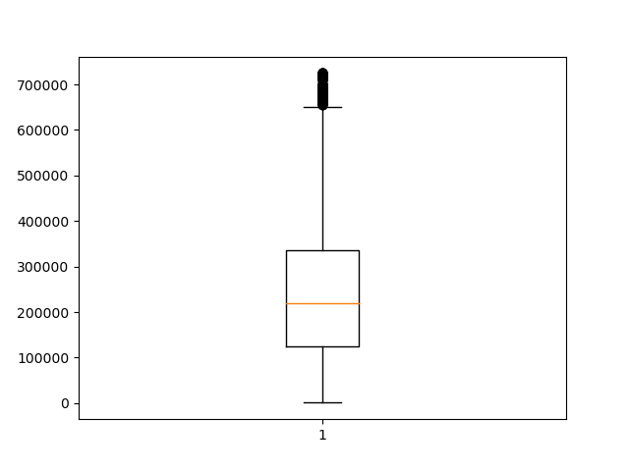
Outlier Detection
Notes:
We also implemented a strategy to handle outliers by setting them to the upper bound of the feature's distribution. This approach helped ensure the robustness of our predictive model and mitigate the influence of extreme values.

Slide 5
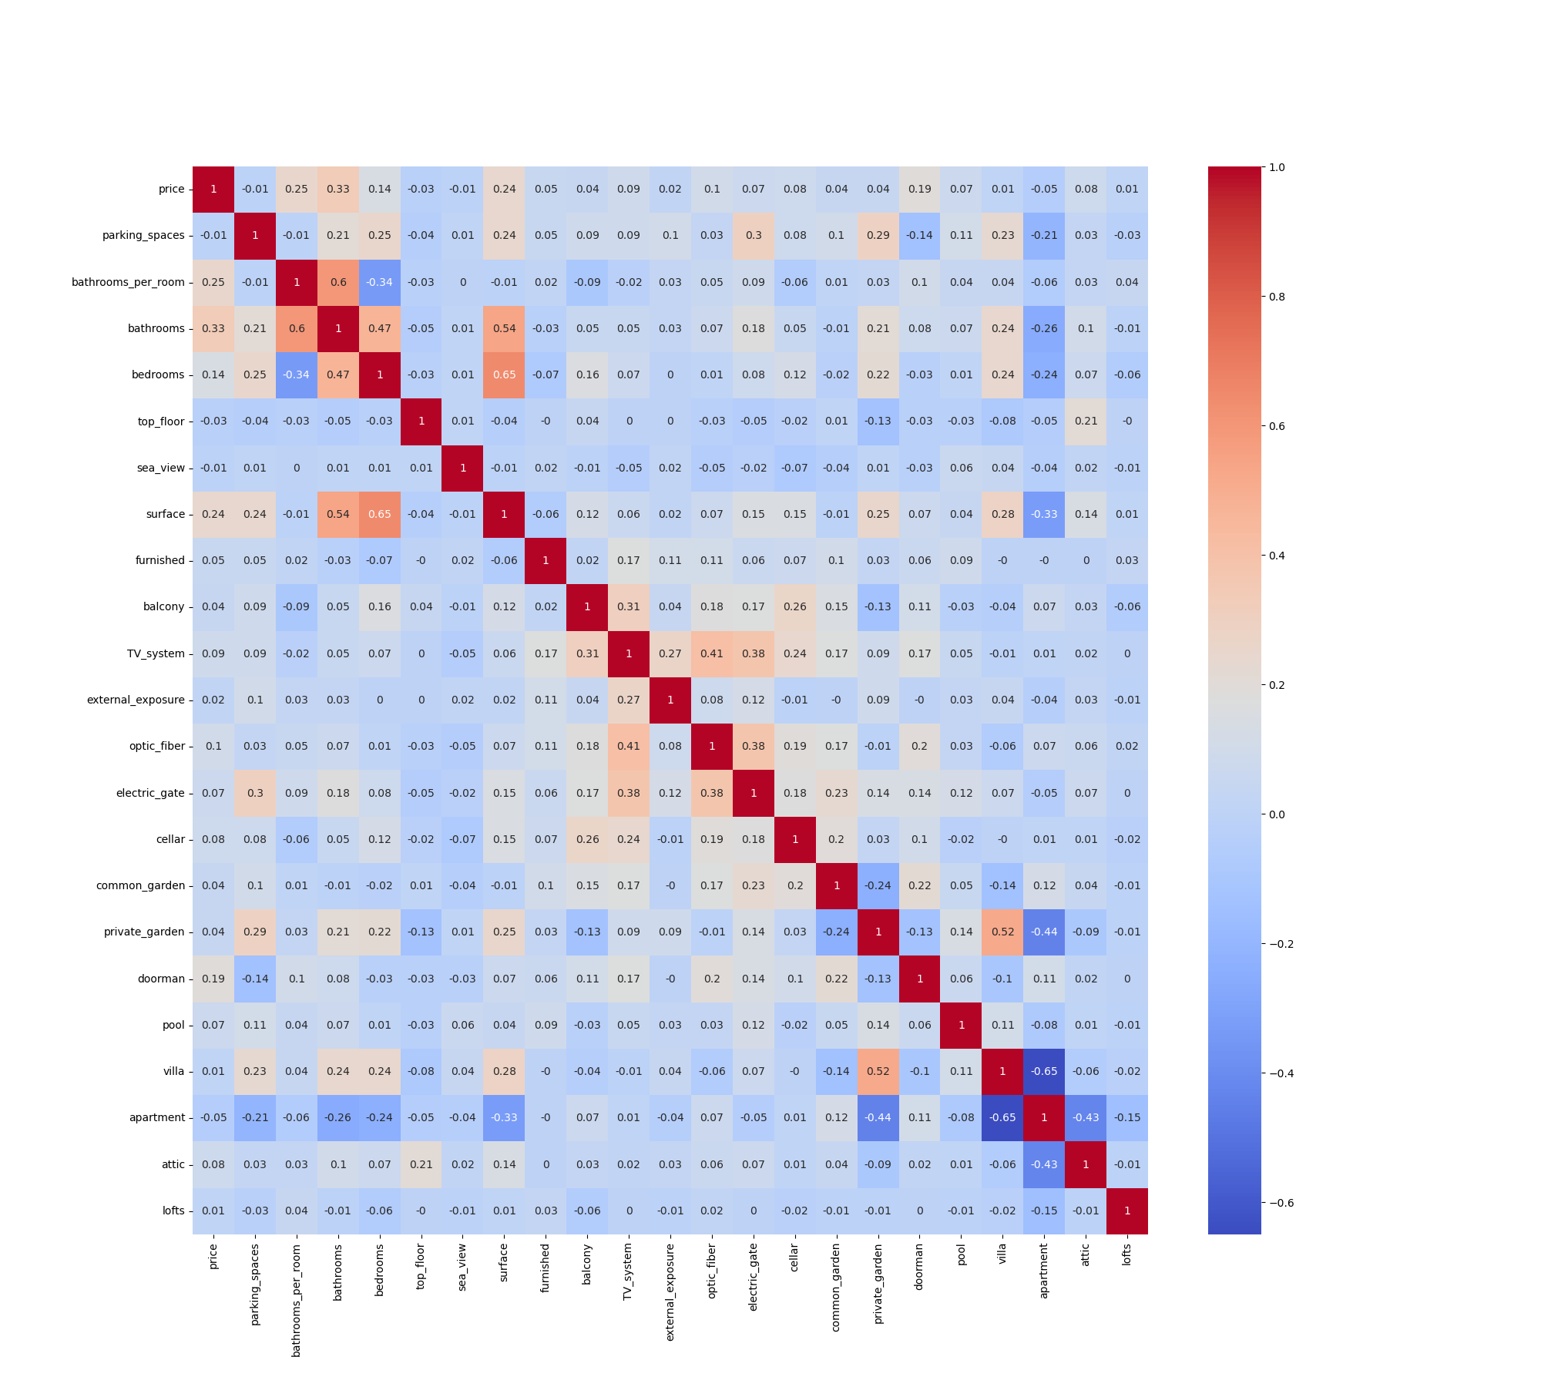
Heatmap Analysis - identify what impacts price

Slide 6
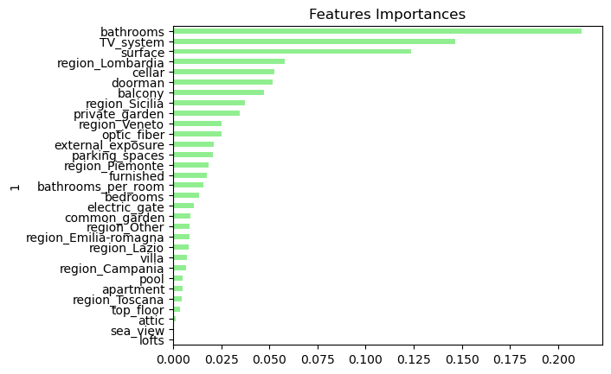
Features Importance

Slide 7
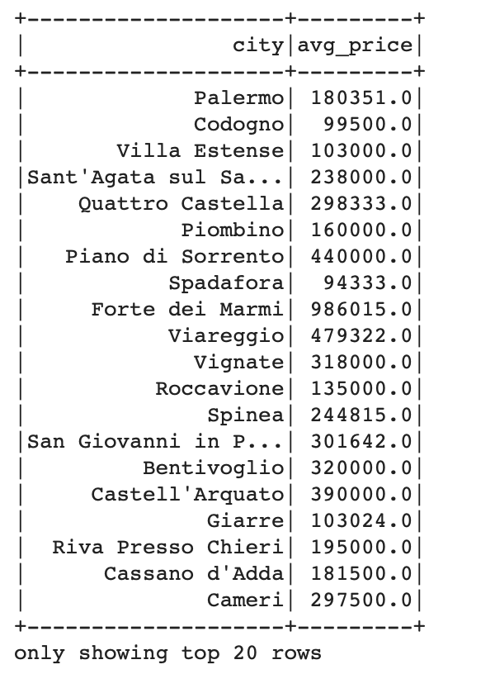
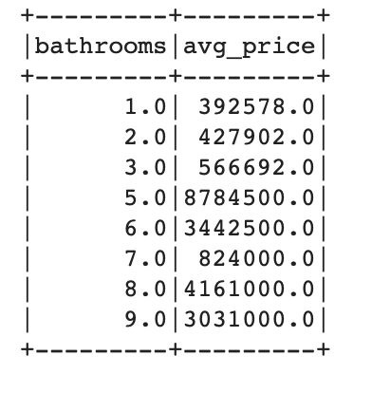
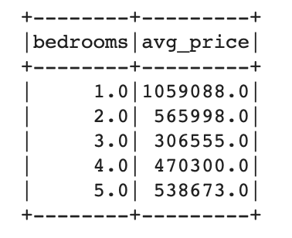
PySpark

Slide 8

Caching Cells

Slide 9
Risk Assessment
Data inaccuracy & missing data.
Additionally, not having enough time.

Slide 10
Conclusion
Created a user-friendly prediction tool, statistical insights, and interactive visualizations, we offer a comprehensive solution for accurately estimating house prices in the Italian real estate market. Our model's strong performance on testing and training data ensures its reliability in practical applications, benefiting a wide range of stakeholders in the real estate industry, while recognizing the inherent variability in real estate prices.
Disclaimer: Market conditions, economic factors, and other external forces can impact property prices. Therefore, our predictions should be considered as estimates based on historical data and property features. Users should exercise discretion and consult with real estate professionals to consider all relevant factors when making real estate decisions.

Slide 11
Further Details
Model Selection - Random Forest
Statistical Insights - Spark SQL
Visualizations - Tableau

